Slide 1
Flutter Introduction course

Slide 2
Goal
Can write simple Flutter app
Can deploy app for testing
Can call Native API app via Flutter
Can integrate with your current Native App

Slide 3
What’s Flutter
UI Framework From Google
One of the most famous Cross platform framework
React Native, Flutter, Xamarin, PhoneGap, Kotlin multi-platform
Near native performance
Dart language

Slide 4
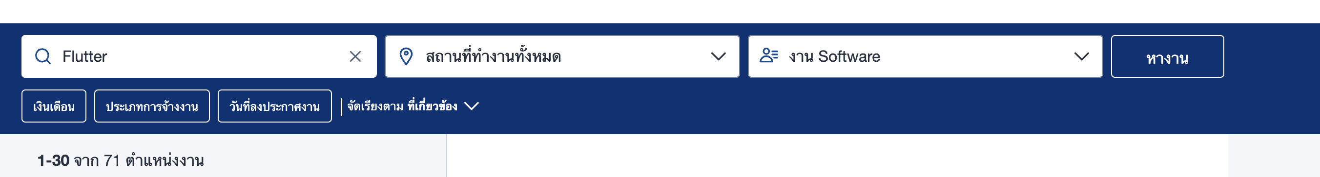
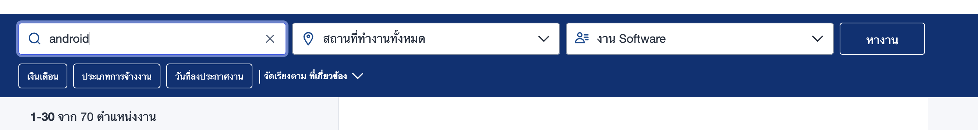
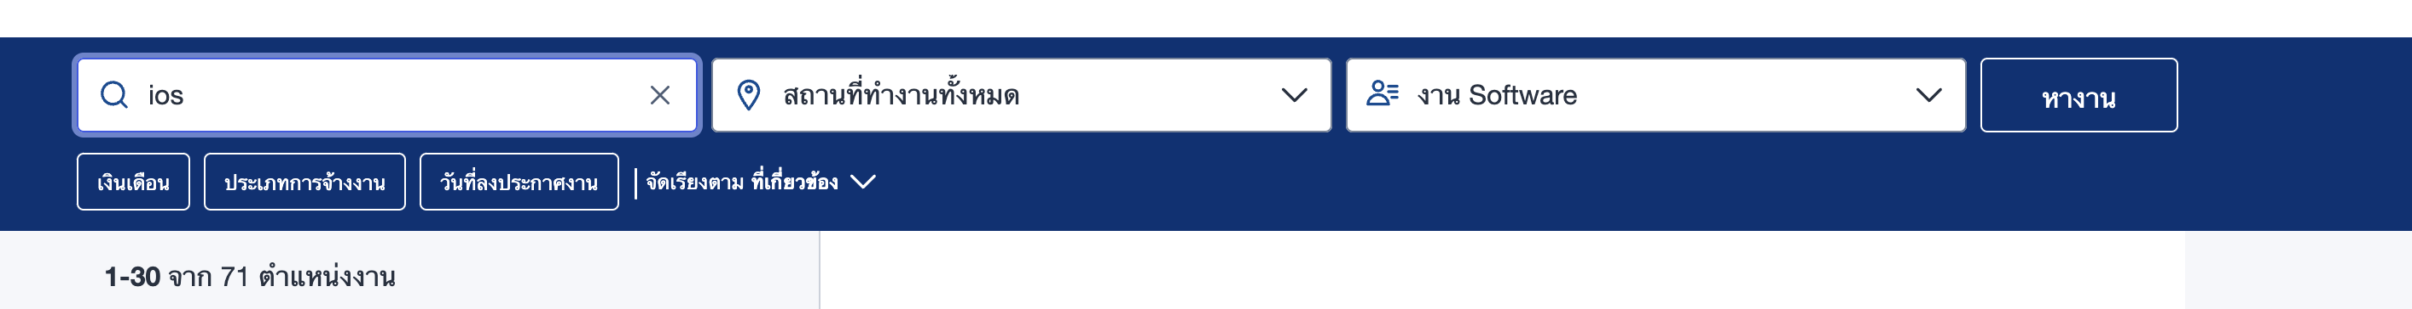
Career

Slide 5
Get Started
How to install. Flutter.dev
Prefer: Mac OS
Prefer IDE: VSCode
Xcode
Android Studio

Slide 6
Start your first Flutter app
iOS Simulator / Android physical device
iOS physical device require developer certificate

Slide 7
Flutter Inspection tools
Inspecting a widget
Break point

Slide 8
What are we going to do in Flutter
Login Page
ListView
DetailsView

Slide 9
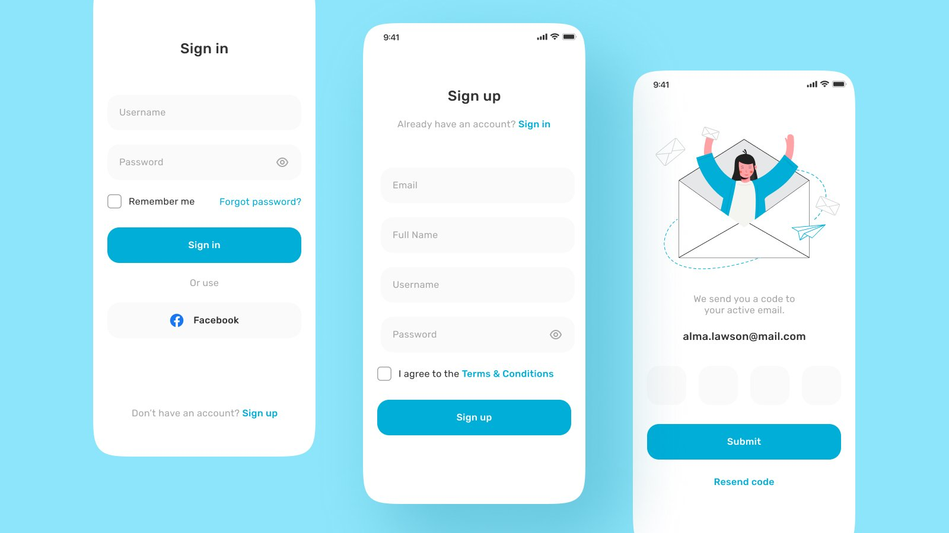

Slide 10
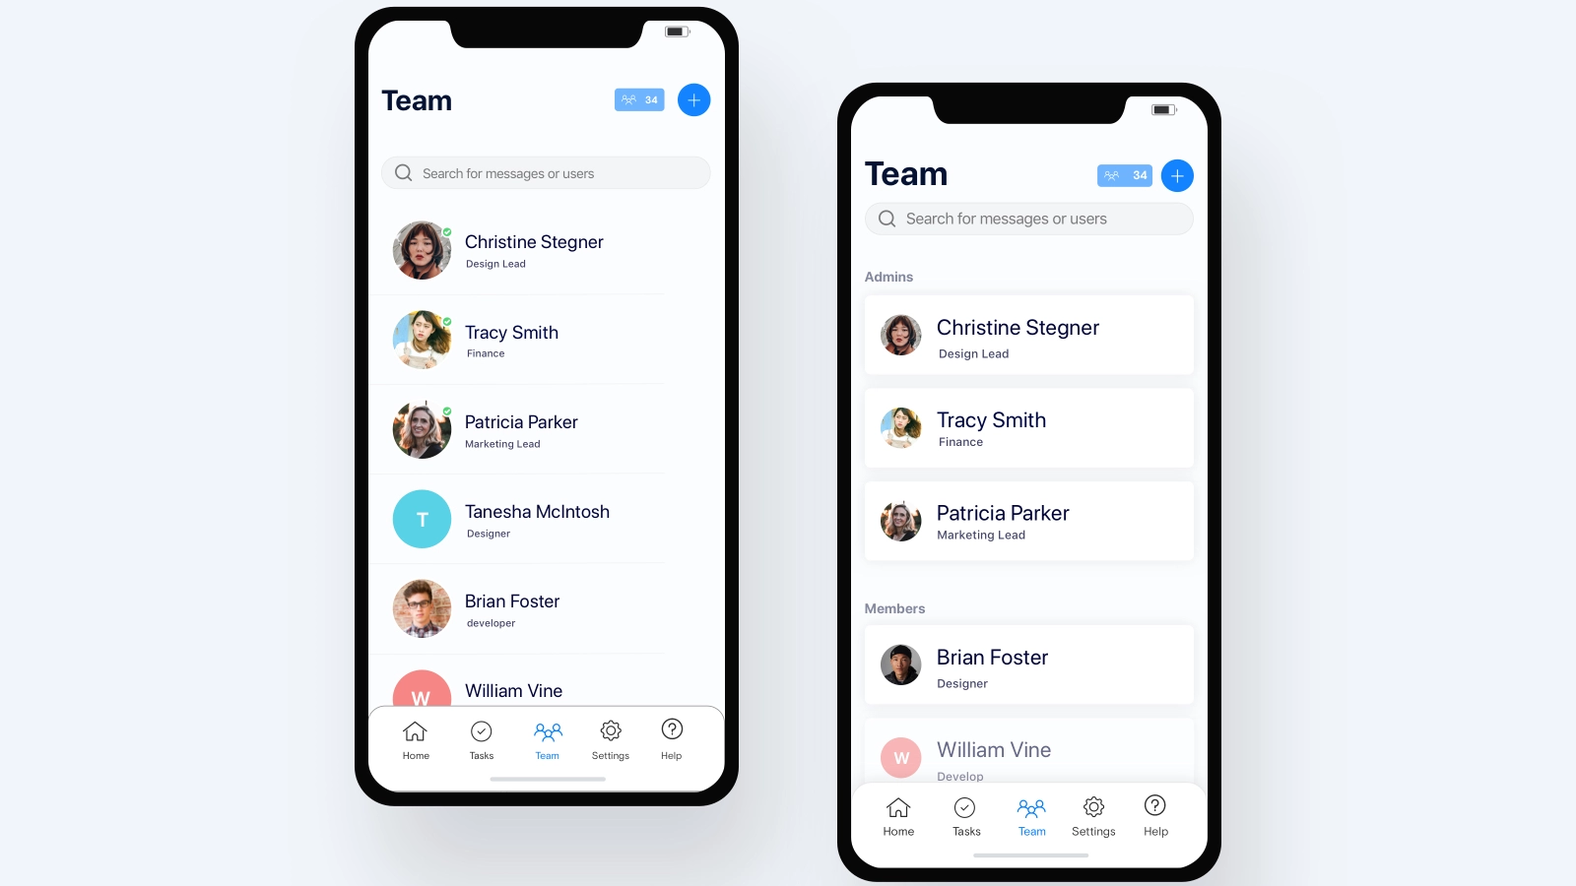

Slide 11
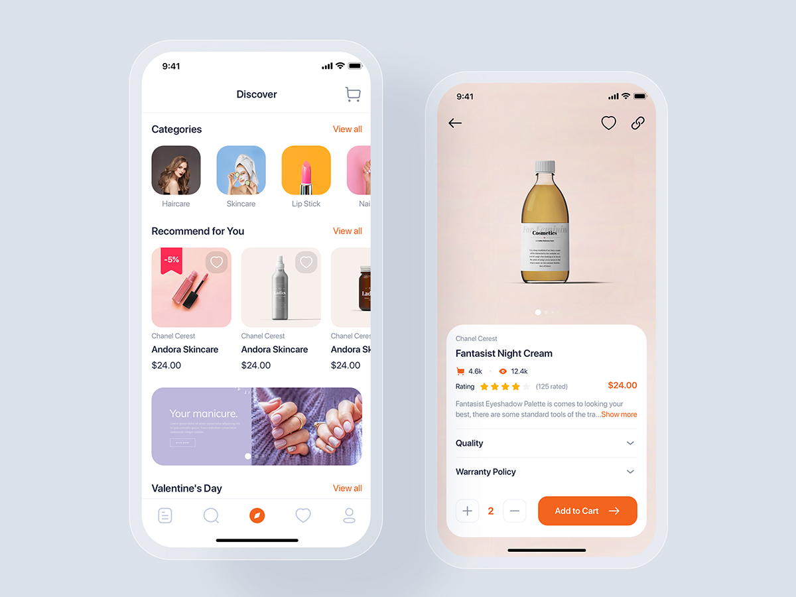

Slide 12
Basic
Row
Column
Text
TextForm
Image
Icon
Button
Container
SizedBox
Scaffold - MaterialApp
Expanded – Spacer - Flex

Slide 13
Let’s do Login page

Slide 14
State management – How to update Data/UI
Local state
App state
Mix and Match
Rules
Parent should always hold data
Child should always hold state
Try to put setState into child

Slide 15
State management approach
Flutter-way
setState
StreamBuilder
ValueListenerBuilder
InheritedWidget (Old style)
Lib-way
Provider
Riverpod
BloC
GetX (use at your own risk)

Slide 16
Advanced
SearchBar
ListView – ListView.builder
Component based UI
Call API

Slide 18

Pub.dev
Flutter is just a UI Framework

Slide 19
Performance Best practice
Control Build
Widget over Helper method
Await is not always good
Const – not really different but why not
Image not too large
Flutter_lint
statelessWidget first
Watch out for animated builder

Slide 20
Project structure
Flutter is BloC Pattern, another name of MVVM

Slide 21
Flutter method channel
You work won’t finish only in Fluttter
Require Native in some work
Native API
Native SDK
Native is faster than Dart in some point

Slide 22
Add-to-App
You have your own native app and want to add more module with Flutter
https://docs.flutter.dev/add-to-app/ios/project-setup
flutter create -t module flutter_module
Add Podfile in your xcode Project

Slide 23

Deploy for testing with Firebase

